Slide 1
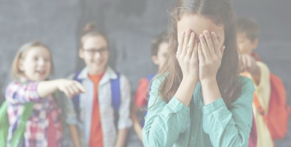
Mediation in practice

Slide 2
What is bullying?
Bullying is systematically and chronically inflicting physical hurt and/or psychological distress on another. Bullying can be physical, verbal or social. It is not just child’s play, but a frightening experience many students face every day. It can be as direct as teasing, hitting, threatening, destruction of property or forcing someone to do something against their will, or as indirect as in rumors, exclusion, or manipulation. Bullying involves a real or perceived power imbalance between the one who bullies and their target.

Slide 3
What is
Cyberbullying?
Cyberbullying is bullying that takes place over digital devices like cell phones, computers, and tablets. Cyberbullying can occur through SMS, Text, and apps, or online in social media, forums, or gaming where people can view, participate in, or share content. Cyberbullying includes sending, posting, or sharing negative, harmful, false, or mean content about someone else. It can include sharing personal or private information about someone else causing embarrassment or humiliation. Some cyberbullying crosses the line into unlawful or criminal behavior.

Slide 4
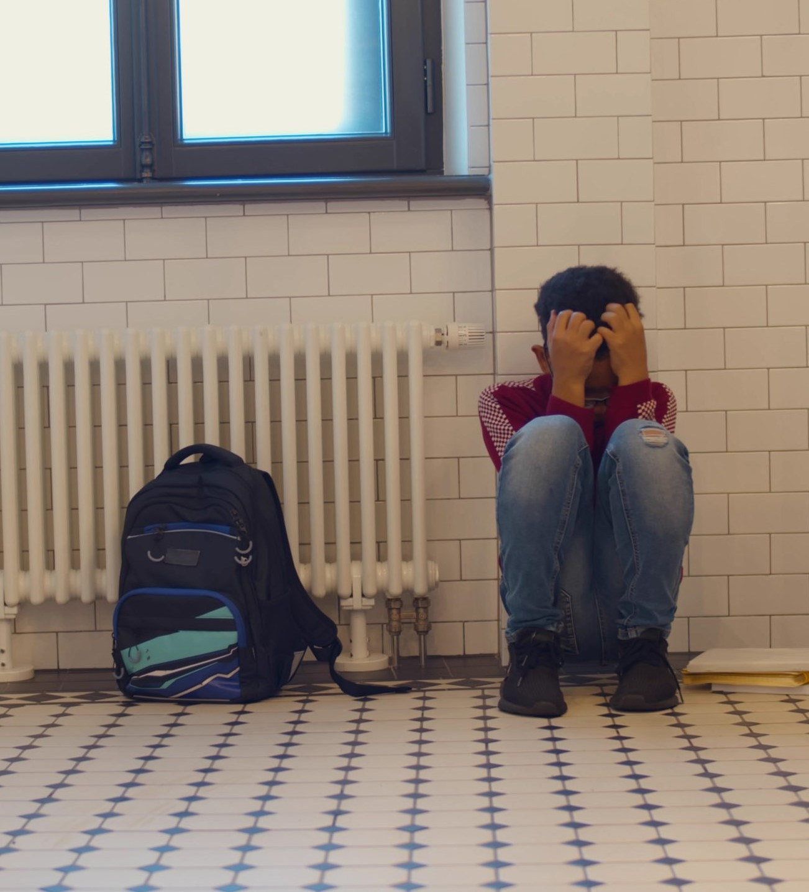
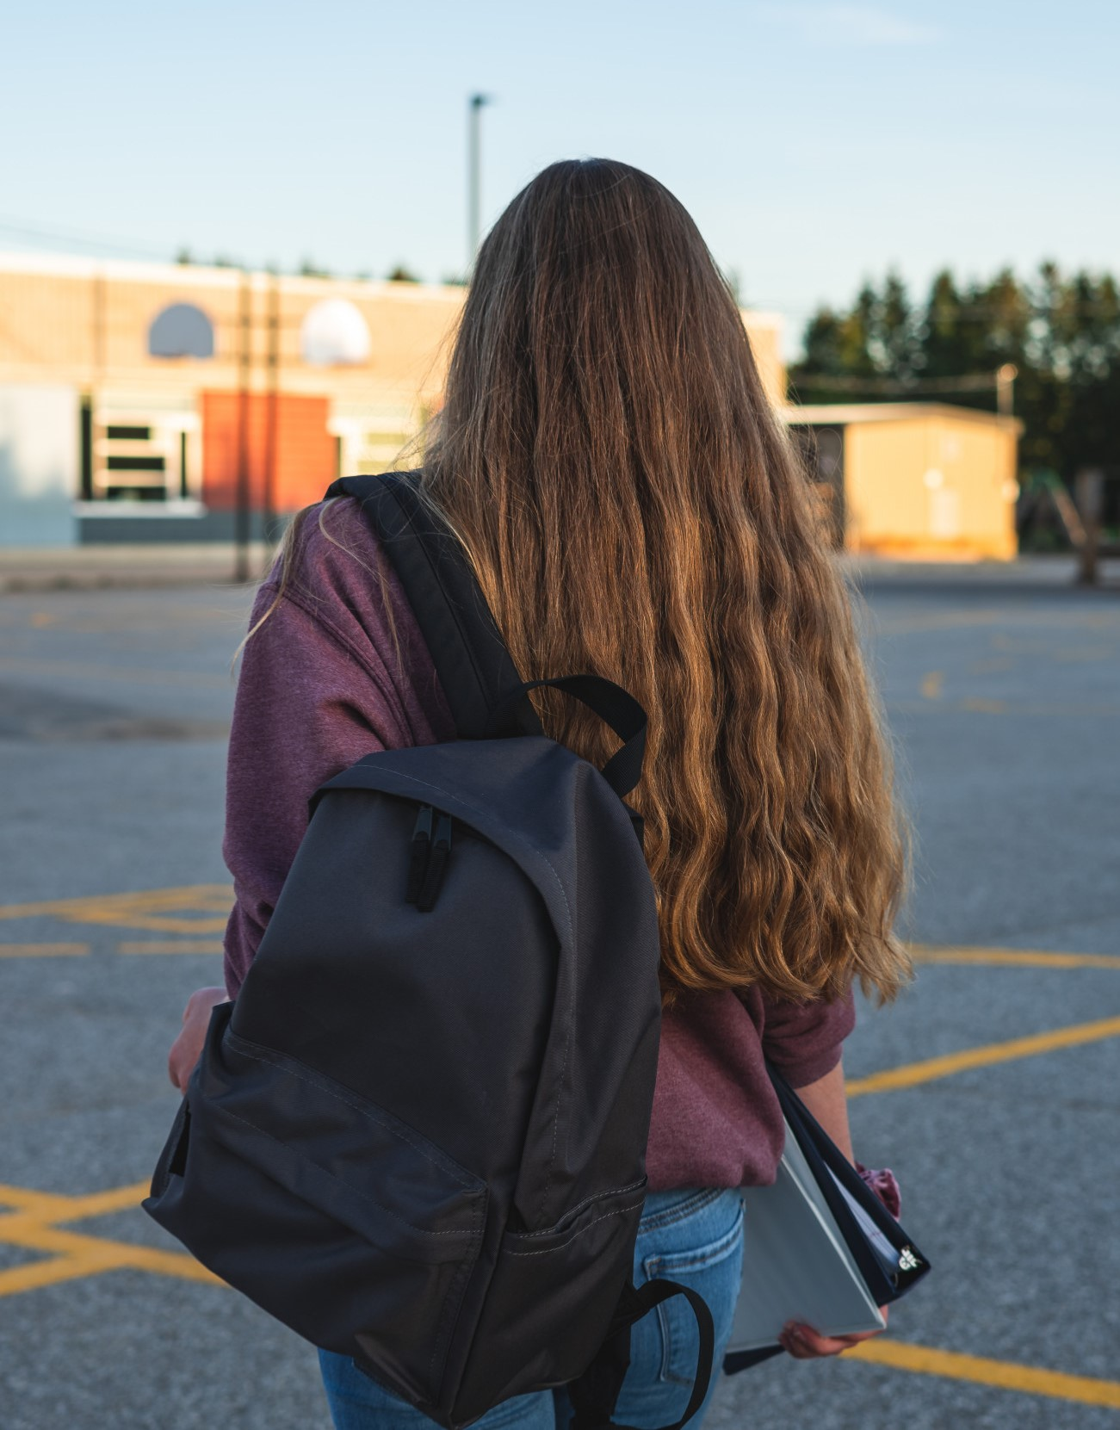
Where does bullying take place?
Bullying occurs during the school day and after school hours. It happens in the school building, in classrooms, hallways, bathrooms, and in the cafeteria; on the playground or other outdoor common areas on school grounds; and on the bus or at the bus stop. It is important to note that bullying occurs most often in areas where there is little or no adult supervision.

Slide 5
Examples OF THINGS THAT STUDENT ARE mostly BULLIED FOR (ACCORDING TO Nea survey)

Slide 6
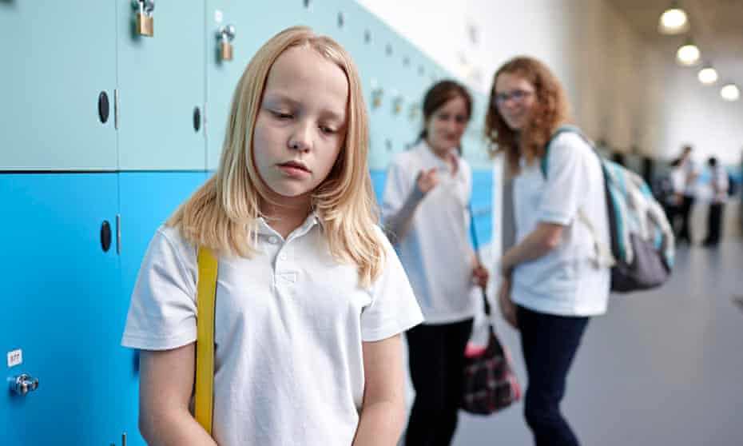
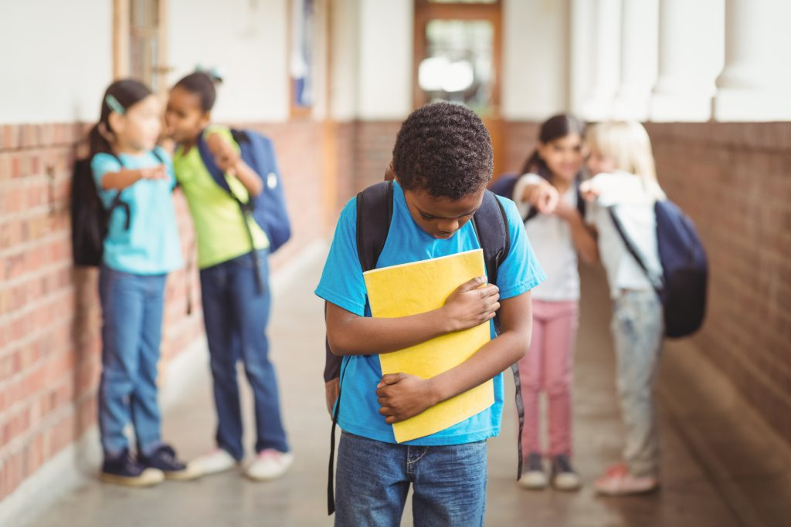
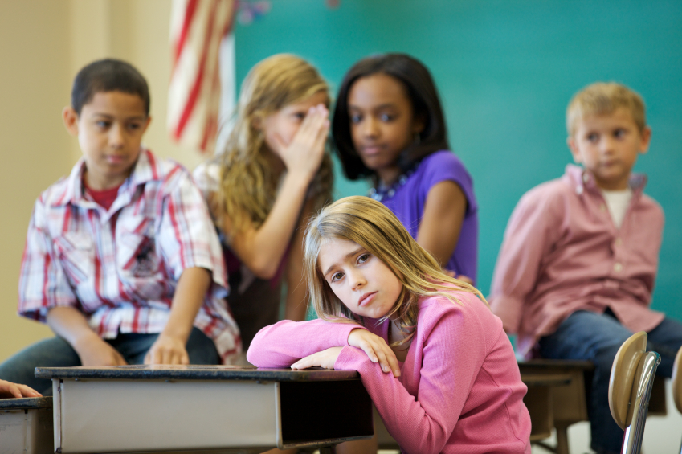
Examples of bullying in schools

Slide 7
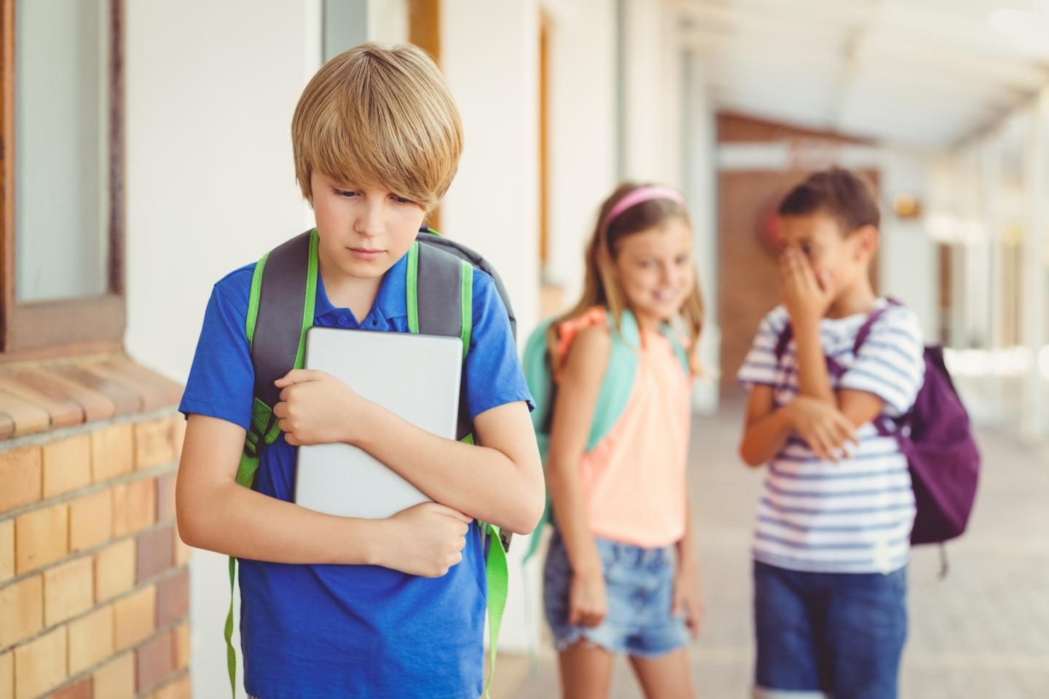
A child with autism spectrum disorder is often followed by a group of students who imitate and mock him. Such a student becomes anxious.

Slide 8
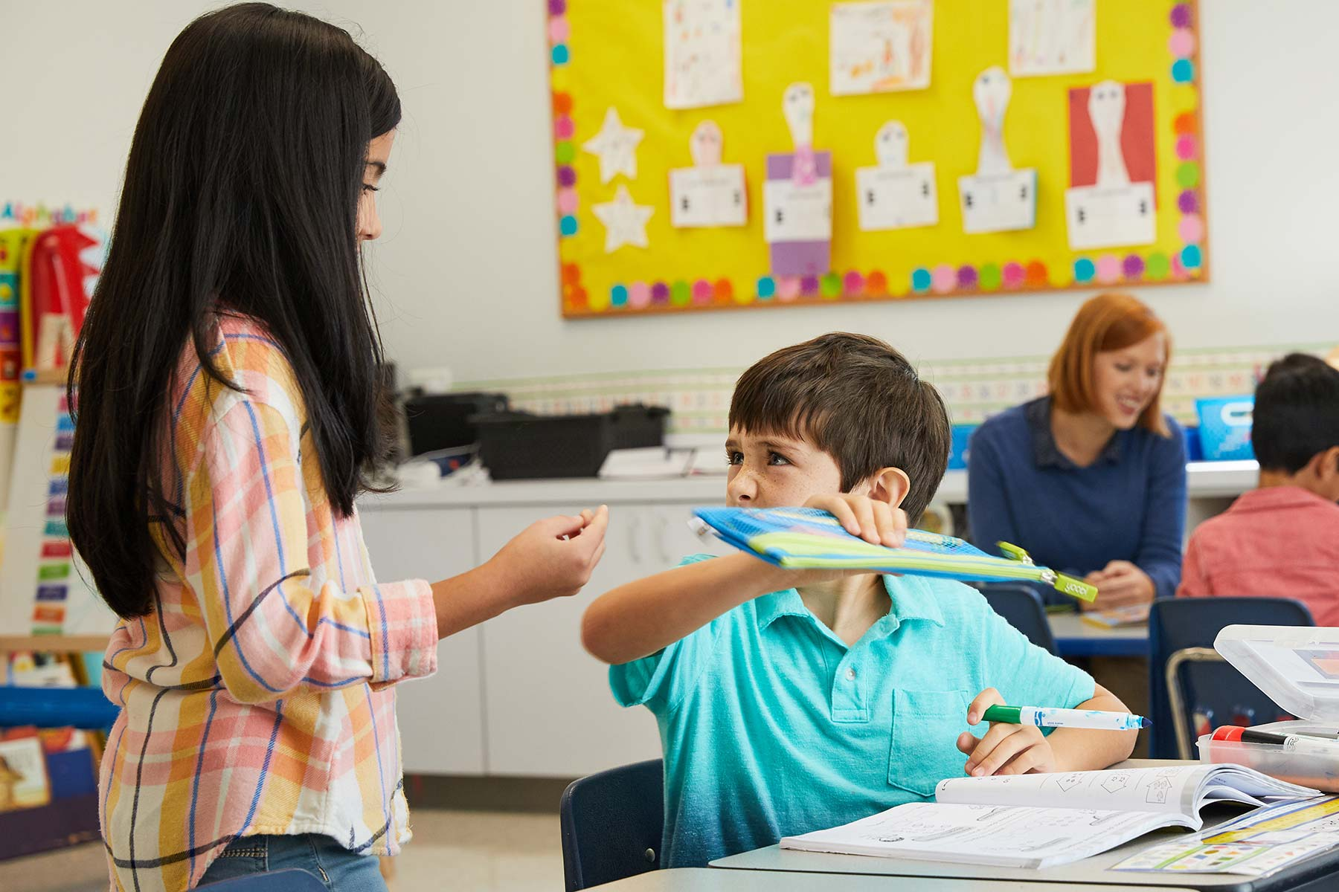
Bullies regularly force a new student in school to give them his lunch. The bullied student does not report the situation because of the fear of reprisals.

Slide 9
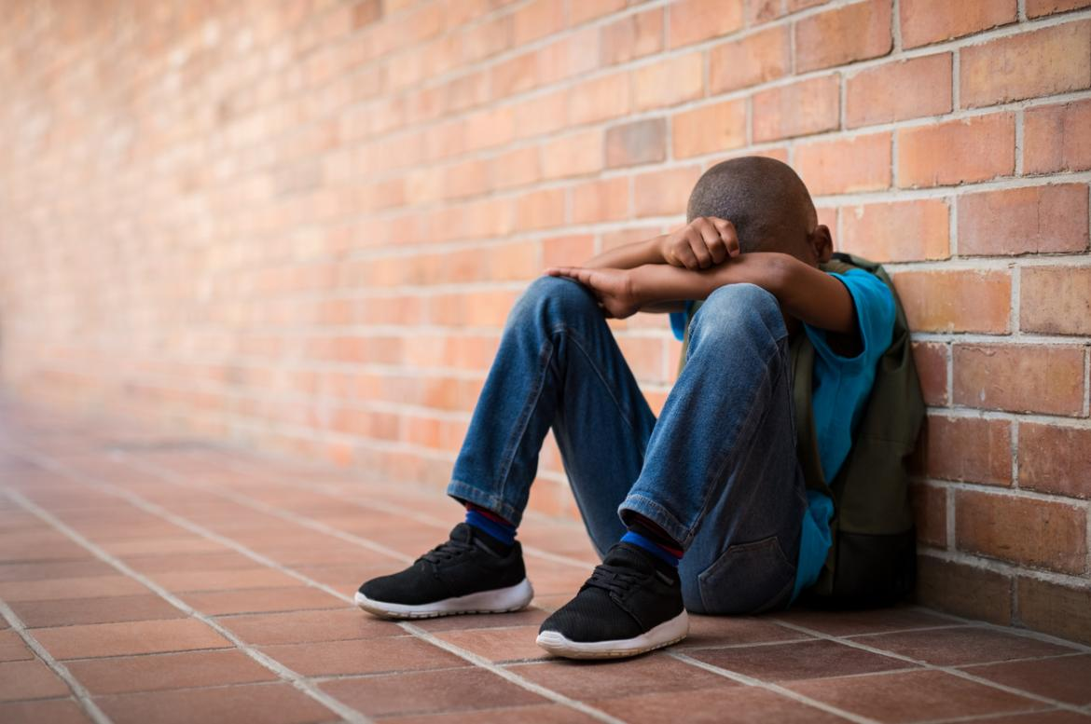
Another example:
a Black youth is the target of repeated racist insults by a group of secondary school students. He doesn't know how to react, starts staying away and has difficulty concentrating, which has negative consequences for his school results and his well-being.

Slide 10
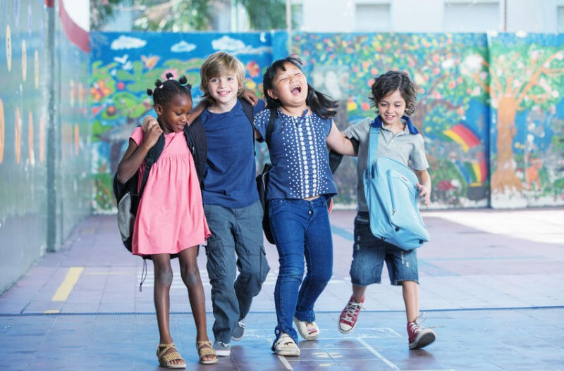
Three essential ways to prevent bullying in schools
Create a positive school climate
2. Raise awareness of Bullying in schools and at home
3. Introduce Bullying Prevention Initiatives in School

Slide 11
How peer mediation can put an end to bullying? The article written by Joanna Sawicka on School education Gateway
Aggression between pupils is an ongoing problem in its various forms – physical aggression, bullying, cyberbullying and social exclusion – but today’s school communities can combat this in an innovative, modern way by means of peer mediation.
Read more : https://www.schooleducationgateway.eu/en/pub/latest/news/peer-mediation-and-bullying.htm

Slide 12
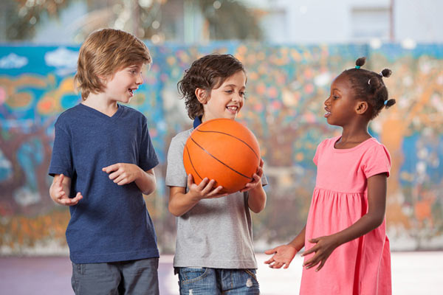
How does peer mediation contribute to prevent bullying?
According to the article, peer mediation programs have been shown to lead to improvement in controlling anger, developing appropriate assertiveness skills, and learning problem solving skills, communication/language skills and other interpersonal skills, as well as increasing empathy, trust, tolerance, respect, and fairness.

Slide 13
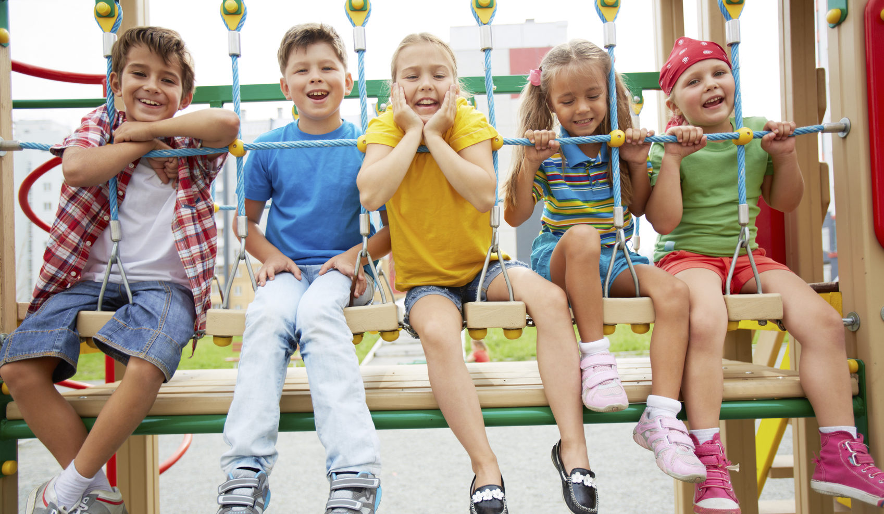
The aims of anti-bullying policy
The main aim is to provide an environment that is physically, emotionally and intellectually safe for all members of a school community.
To achieve it the school has to:
Prevent the occurance of bullying
Develop individual self-esteem and respect for others
Combat bullying by processes of reconciliation (mediation) and sanctions

Slide 14
What are the best ways to prevent bullying in schools?
Two research-tested approaches that show the most promise for reducing bullying (along with other forms of aggression and conflict) are a positive school climate, and social and emotional learning.

Slide 15
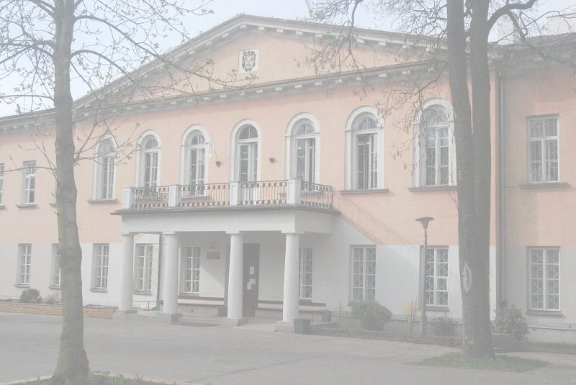
Do we have Cases of bullying and Cyberbulling in our school?
Fortunately, such cases rarely occur. We have always tried to ensure that there are no conflicts in our school. They are unnecessary and destroy our school atmosphere. And even if such conflicts occur, we quickly try to resolve them and bring about an agreement.

Slide 16
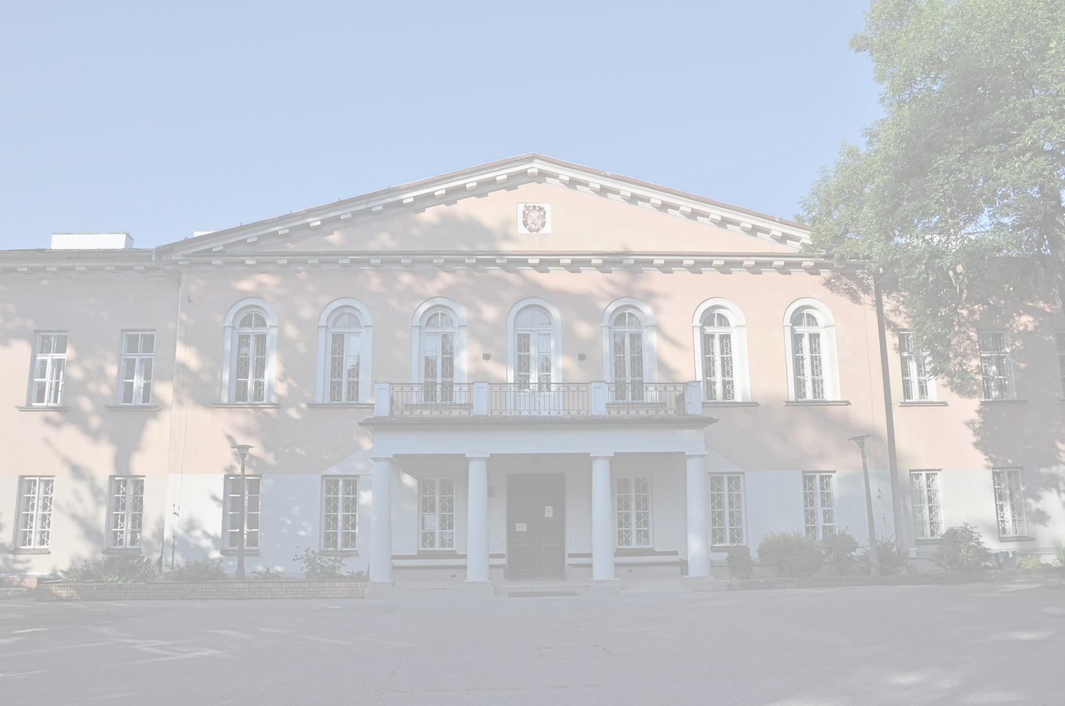
Is our school student-friendly?
Of course! Everyone in our school contributes to its unique and student-friendly atmosphere. We organize integration meetings between students to get them better acquainted with each other. We also try to teach to show them that consent can always do the most, and even the greatest conflicts can be resolved without the use of force. All you need is good will and willingness to act. Our school combines all these features.

Slide 17
Thank you for your involvement!
Prepared by VILO students and coordinating teacher.

